Slide 1

Introduction to Hair analysis in forensic science
11th November 2020
https://askinglot.com/open-detail/198926

Slide 2
Hairs
Hairs grow from the base of the follicle upward.
Hair is made of keratin, a tough-protein based material from which nails and horns are made in animals.
Sebaceous glands produce oils that coat hairs, helping to keep them soft and pliable.
At the end of the follicle is a network of blood vessels that supply nutrients to feed the hair and help it grow. This is called the papilla.
The lower end of hair root
https://askinglot.com/open-detail/198926
Notes:
hair papilla จะมีส่วน hair matrix ซึ่งเกิดการแบ่งเซลล์ เปลี่ยนแปลงเป็นเซลล์ที่มี keratin อยู่ภายใน ทำให้ผม/ขนยาวขึ้น (growth zone)

Slide 3
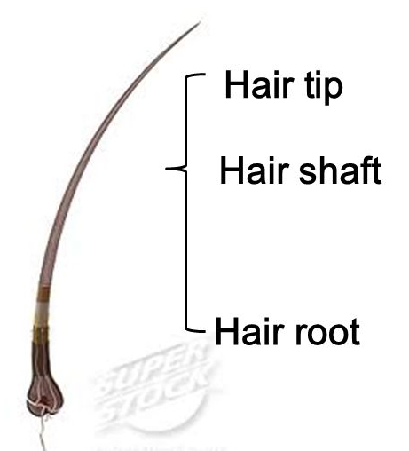
Hair structure
Generally, a single hair on a macro scale is composed of a root, a shaft, and a tip.
The root is the portion that formerly was in the follicle, the proximal (the direction toward the body) most portion of the hair.
The shaft is the main portion of the hair.
The tip is the distal (the direction away from the body) most portion of the hair.
https://slideplayer.com/slide/7480900/

Slide 4
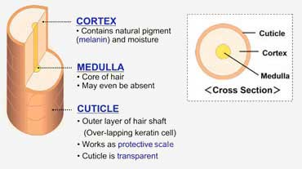
Internally structural elements in hairs
The cuticle of a hair is a series of overlapping layers of scales that form a protective covering.
The cortex makes up the bulk of the hair. Pigment granules are found in cortex and dispersed variably throughout the cortex.
The medulla is the inner layer which essentially is an air-filled channel inner layer.
https://sshairartistry.com/thehairblog/2019/1/23/uii2akb9c4cqz88h2tnxfeuppqwrhv

Slide 5

Five different patterns of medulla used in forensic hair analysis

Slide 6
Hairs from different parts of the body
The physical characteristics of hairs provide information about which part of the body they came from.
https://askinglot.com/open-detail/198926

Slide 7
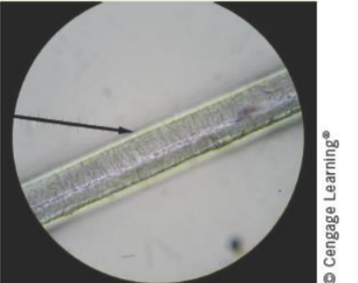
Treated hairs
Hair can be treated in many different ways such as bleaching and dyeing.
Bleaching disturbs the scales on the cuticle and removes pigments leaving hair brittle and a yellowish color.
Dyeing colors the cuticle and the cortex of the hair shaft.
If an entire hair is recovered in an investigation, it is possible to estimate when the hair was last color-treated. The region near the root of the hair will be colored naturally.
Bleached hair lacks pigment in cortex.
Examples of dyed human hair
https://msrobbinspnhs.weebly.com/uploads/1/4/1/6/14166475/fsci_ch_03_final.pdf

Slide 8
When was the hair last color-treated?
FACT : Human hair grows at a rate of about 1.3 cm per month (approximately 0.44 mm per day).
If an entire hair is recovered and the region near the root of the hair with colored naturally is measured to be 2.5 cm, when was the hair last color-treated?
Ans : 2.5 cm divided by 1.3 cm per month equals approximately 1.9 months or about 7 weeks.
The hair was last color-treated about 7 weeks ago.

Slide 9
Racial differences

Slide 10
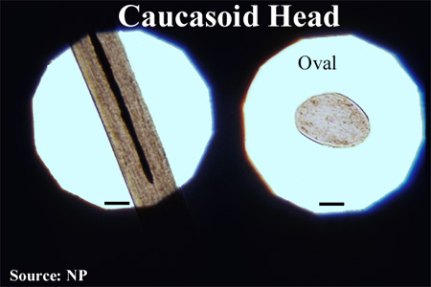
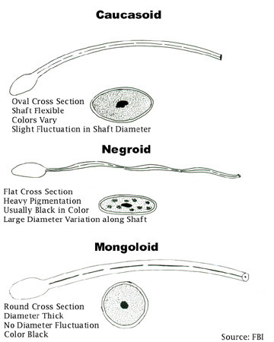
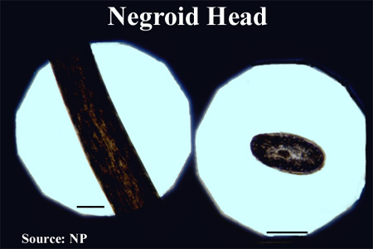
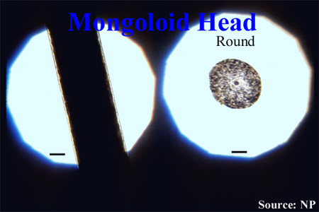
Racial differences
Microscopic Evidence and Its Analysis

Slide 11
Human versus animal hairs
An initial analysis is performed using a low-power compound microscope to determine whether the hair is human or animal
There are 3 main characteristics used to differentiate human and animal hairs
1. medulla thickness and shape
The ratio of the diameter of the medulla to the diameter of the entire hair is known as the medullary index. If the medullary index is 0.5 or greater, the hair came from an animal. If the medullary index is 0.33 or less, the hair is from a human
2. Cuticle shapes
Human hair has cuticle scales that are flattened and narrow, also called imbricate.
3. pigment
Color and pigmentation evenly distribute throughout the human hair shaft. Human hairs are usually one color along the length. Animal hairs can change color abruptly in a banded pattern.

Slide 12
Human vs animal hairs - medulla
The medulla is typically wider and more well defined in animal hairs.
https://slideplayer.com/slide/6518483/

Slide 13

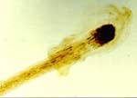
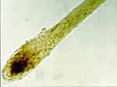
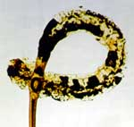
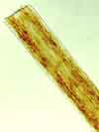

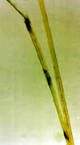
Microscopic Evidence and Its Analysis
Microscopic Evidence and Its Analysis
- Root Characteristics: Removal
Pulled
Forcibly removed
Shed
- Tip Characteristics
Burned
Cut
Razored
Split
Notes:
Hair development is divided into three stages: anagen (growth), catagen (resting), and telogen (dormancy).

Slide 14
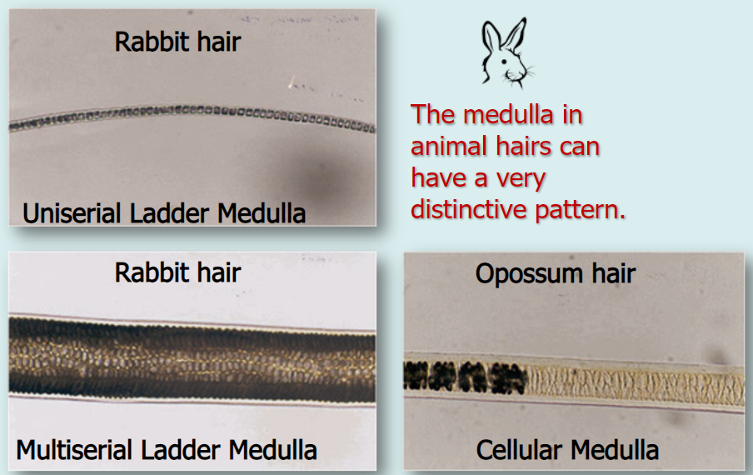
Human vs animal hairs - medulla
https://slideplayer.com/slide/6518483/
Notes:
Amorphous: no specific pattern
Uniserial: small blocks in a row
Multiserial: several rows of blocks across
Vacuolated: uneven pattern
. Lattice: circular patterns

Slide 15
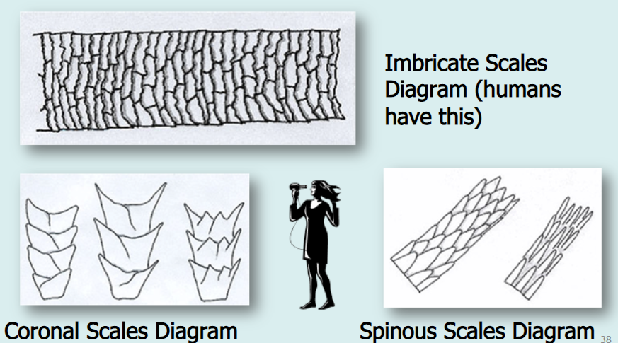
Human vs animal hairs – cuticle scales
The scales point from the proximal end of the hair to the distal end.
Human hair has cuticle scales that are flattened and narrow, also called imbricate.
https://slideplayer.com/slide/6518483/

Slide 16
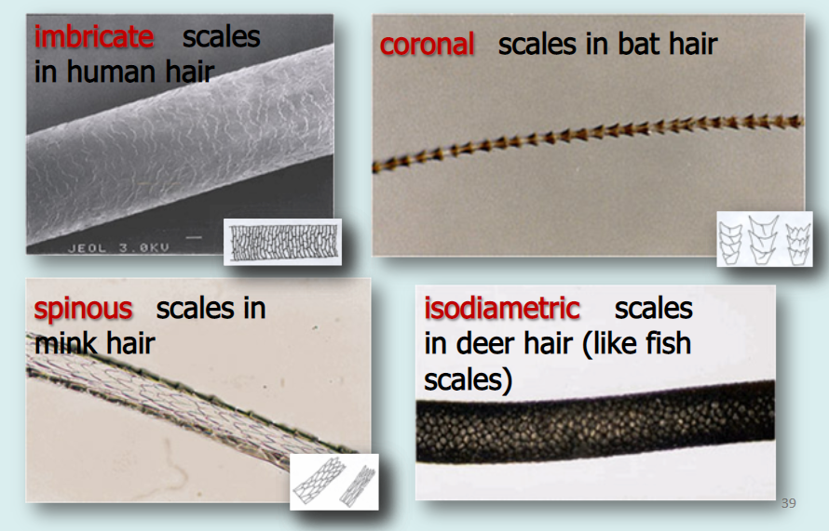
Human vs animal hairs – cuticle scales
Rodents and bats have a coronal cuticle with scales that give the appearance of a stack of crowns.
Cats, seals, and mink have scales that are called spinous and resemble petals.
Human hair has cuticle scales that are flattened and narrow, also called imbricate.

Slide 17
Information provided by a hair examination
Is it human or animal hairs?
What is the possible race of the donor?
What area of the body did it come from?

Slide 18
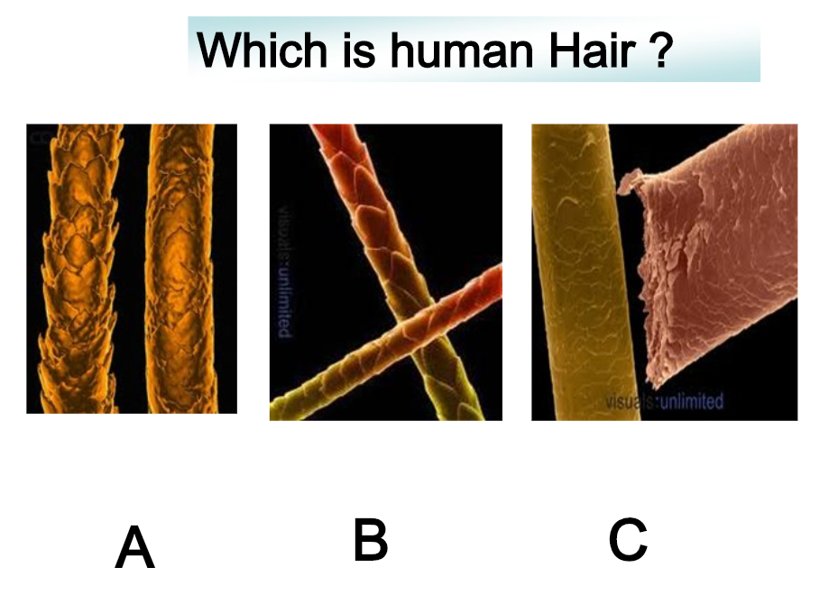
https://slideplayer.com/slide/7480900/

Slide 19
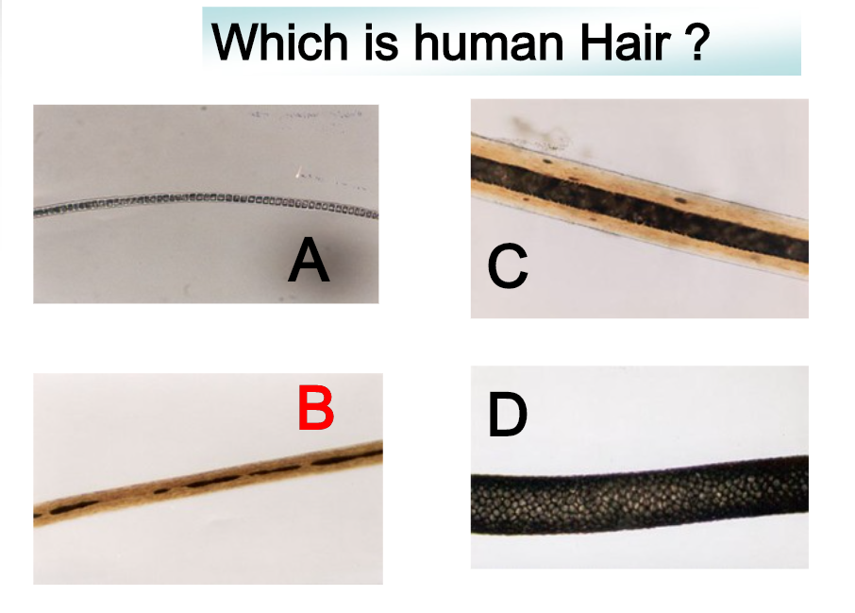
https://slideplayer.com/slide/7480900/

Slide 20
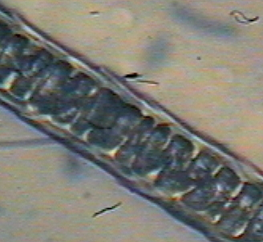
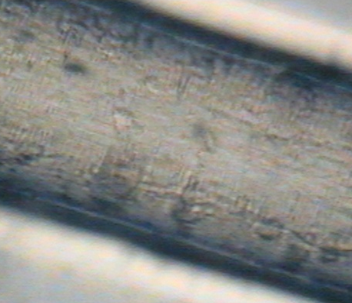

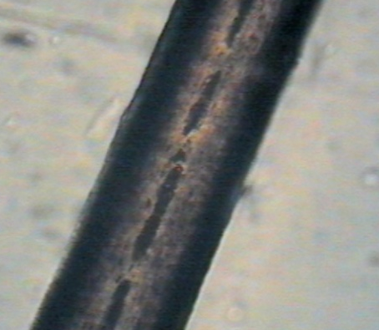
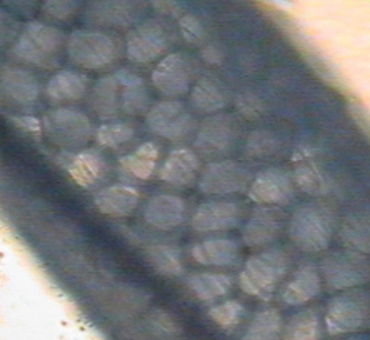
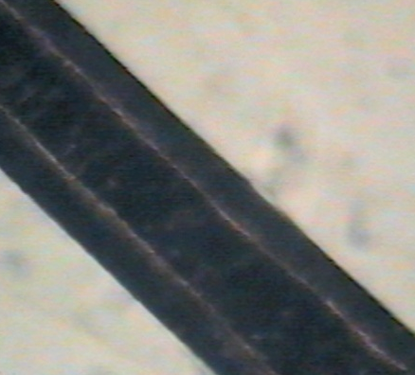
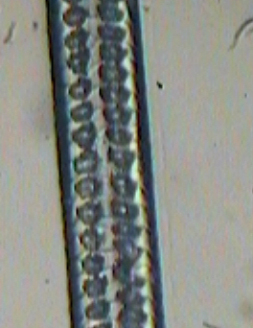
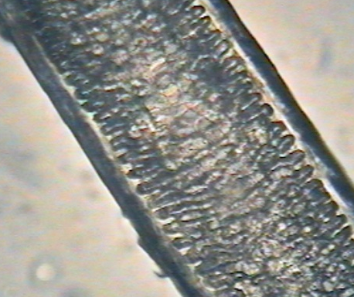
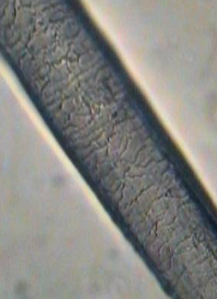
Can you identify the animal hairs shown?
A
B
C
D
G
E
F
H
I
Think About It …
In which samples are we viewing the cuticle? How do they compare?
(2) In which samples are we viewing the medulla? How do they compare?
(3) What characteristics can be used to identify hair samples?
Notes:
A = cat
B = Horse
C = Pig
D = Human
E = Dear
F = dog
G = rabbit
H = rat
I = human

Slide 21
References
M M Houck and J A Siegel, “ Fundamentals of Forensic Science”, 2nd edition, Academic Press (2010).
A Langford, J Dean, R Reed, D Holmes, J Weyers and A Jones, ”Practical Skills in Forensic Science”, 2nd edition, Pearson (2010).
https://slideplayer.com/slide/6518483/
https://askinglot.com/open-detail/198926
https://msrobbinspnhs.weebly.com/uploads/1/4/1/6/14166475/fsci_ch_03_final.pdf

